Slide 1
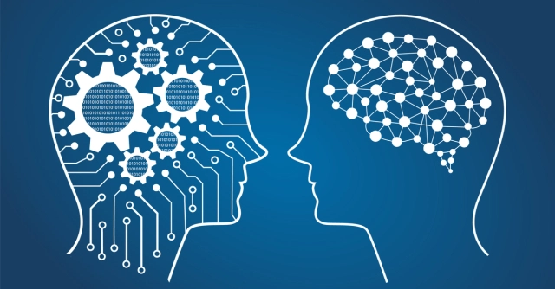
Random Forest Analysis: An Introduction to Machine Learning
Marcus Blum, Jason Gundlach, Jerrod Merrell

Slide 2
What is Machine Learning?
Term first coined in 1959 by Arthur Samuel, an American computer scientist
“Computer’s ability to learn without being explicitly programmed.”

Slide 3
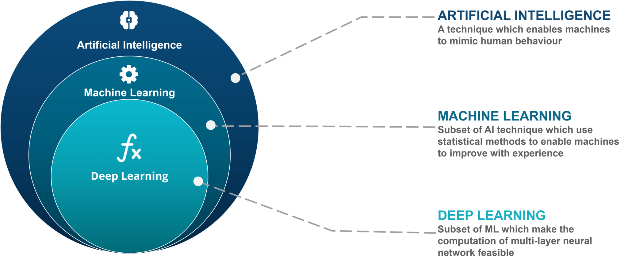

Slide 4

Subsets of Machine Learning
Three main types of machine learning algorithms:
Reinforcement
Unsupervised
Supervised

Slide 5
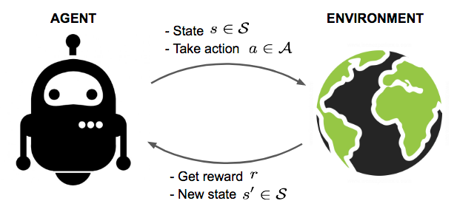
Reinforcement Learning
An agent learns how to behave in a specific environment by performing actions and seeing the results
Predicated on the Reward Hypothesis
All goals can be described by the maximization of expected cumulative reward
Usually modeled as Markov Decision Process (MDP)
Trial-and-error learning
Agent’s actions influence the subsequent data it receives

Slide 6
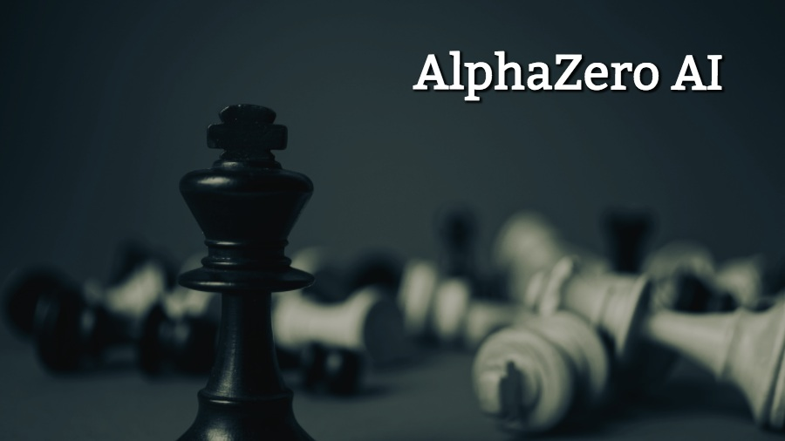

Slide 7
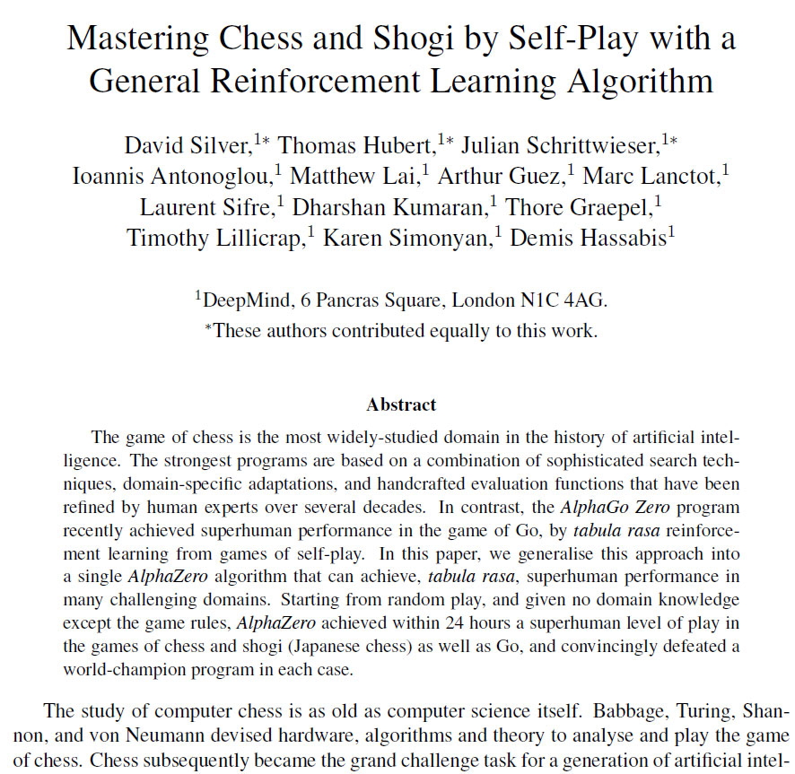

Slide 8
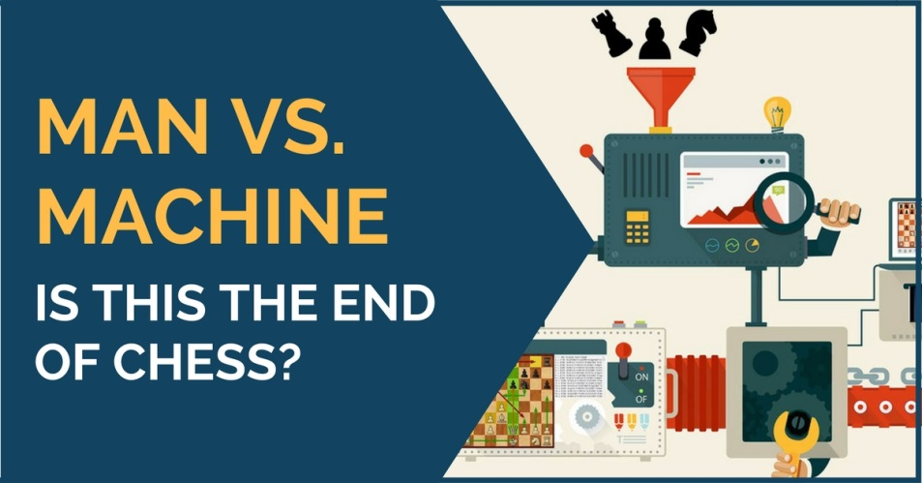
AlphaZero crushes strongest chess engine in the world without human assistance
100 game match played between AlphaZero AI and Stockfish chess engine
AlphaZero dominates by score of 28 wins, 0 losses, 72 draws after only 4 hours of learning
Stockfish ran on CPU that was 900 times faster (32 cores), and processed 70 million positions per second, while AlphaZero was only processing 80 thousand positions per second
Showcased incredible potential of basic reinforcement learning algorithms

Slide 9
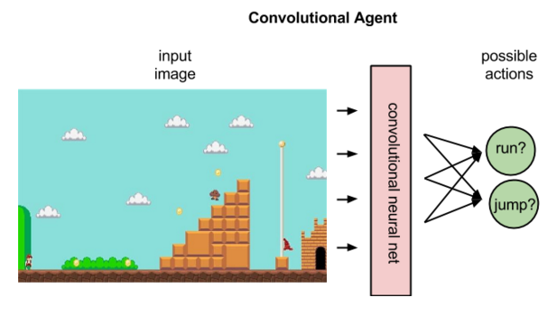
Common Applications of Reinforcement Learning Algorithms
Game playing (chess, checkers, go, shogi, backgammon, etc)
Robotics
Elevator scheduling
Telecommunications
Traffic Light Control
Chemistry
Websites

Slide 10
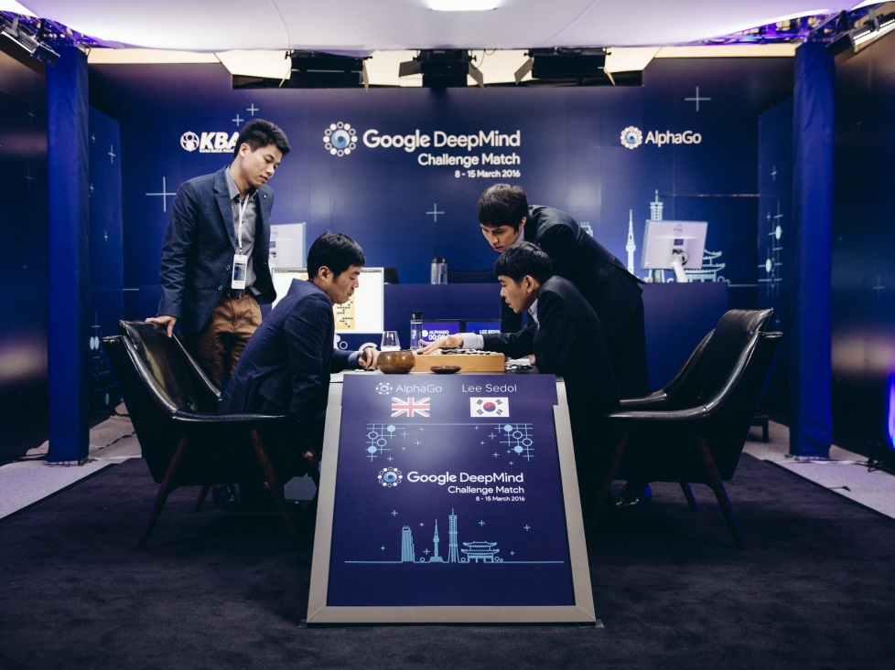
Weaknesses of Reinforcement Learning
Assumes every environment or process is Markovian
Assumes all actions are discrete
Assumes all agents can be manipulated by reward perfectly

Slide 11
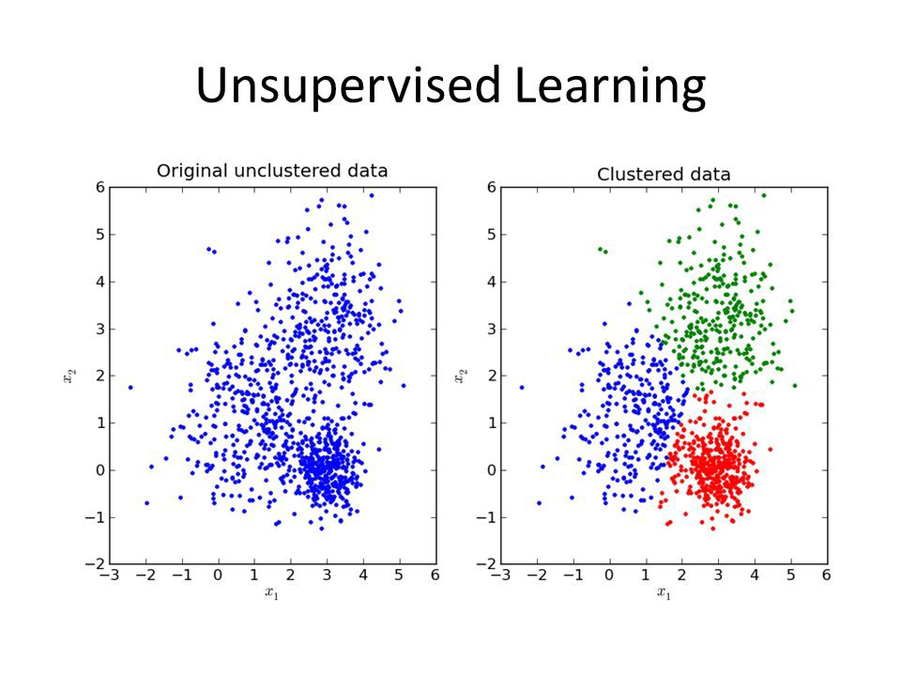
Unsupervised Learning
Primary goal is to identify patterns or structure within unsorted data
Algorithms act upon data without prior training or an idea of the structure of the data
As data is assessed, ability to make decisions improves and becomes more precise
Cluster analysis and density estimation

Slide 12
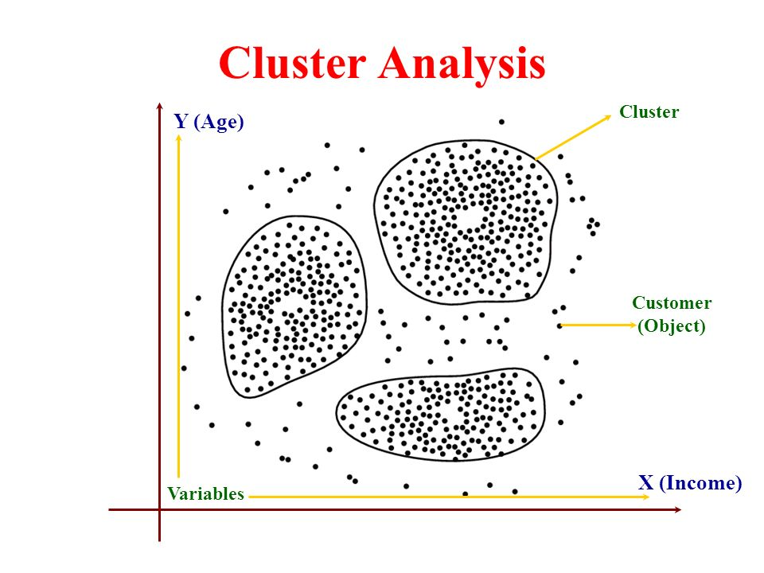
Cluster Analysis
Algorithms group objects into clusters
Primary component of data mining (extracting patterns in large data sets)
Useful for partitioning data so that analyses can be performed on each data set to find patterns

Slide 13
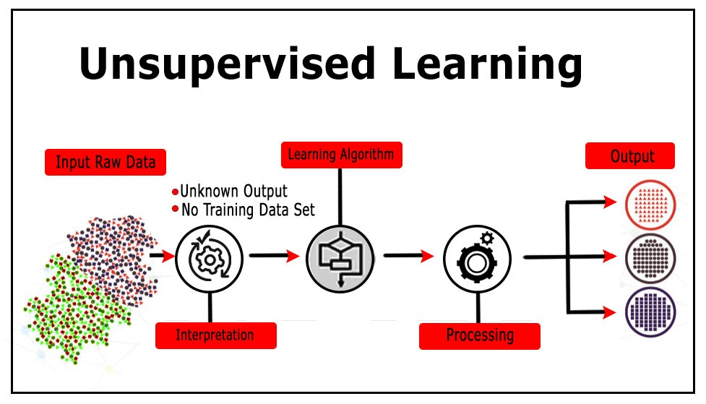
Common Applications of Unsupervised Learning
Pre-processing data for other algorithms or analyses
Grouping tasks
Data mining
Market segmentation and advertisement
Useful for unlabeled data

Slide 14
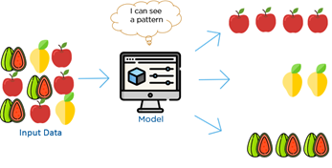
Weaknesses of Unsupervised Learning
Difficult to ascertain if the results are meaningful or not
More subjective than supervised learning due to lack of a goal

Slide 15
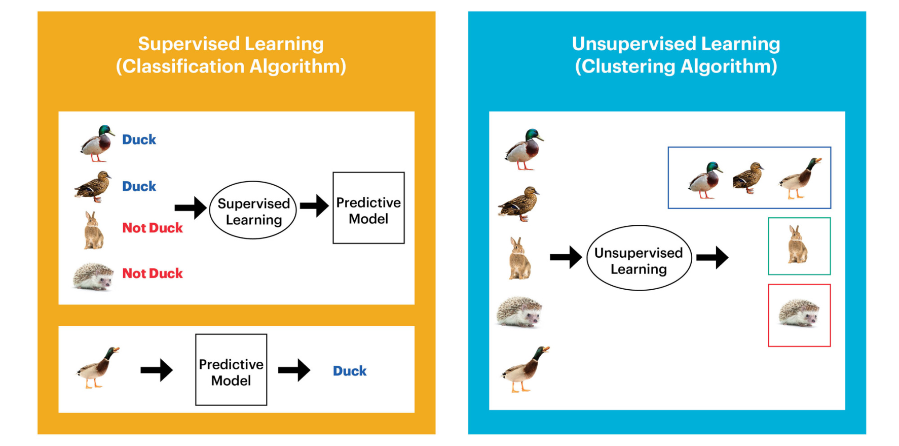
Supervised Learning

Slide 16

What is Supervised Learning?
Machine is taught by example
Algorithm is provided with known dataset that includes inputs/outputs
Algorithm then identifies patterns in data, learns, and makes predictions

Slide 17

Steps
1) Gather training data
2) Data preparation
3) Choose your model
4) Training
5) Evaluation
6) Parameter Tuning
7) Prediction

Slide 18
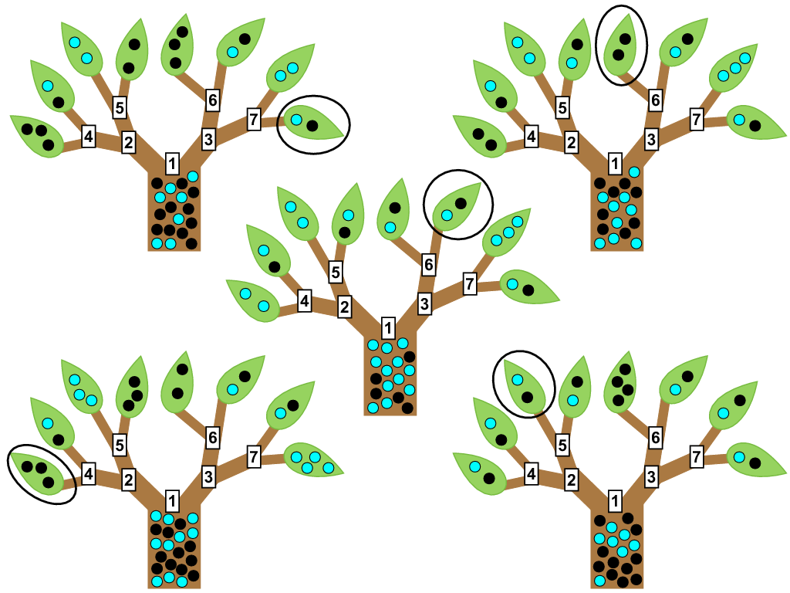
Types of Supervised Learning
Classification
Draws a conclusion from observed values and determines what category new observations belong
Random Forest
Regression
Estimates relationships among variables
Forecasting
Makes predictions about the future based on past and present data
Semi-supervised learning
Combines labelled and unlabelled data, and then learns to label

Slide 19

Weaknesses of Supervised Learning
Correct training vital for high performance
Deep hierarchies present problems
Unconstrained individual trees are prone to overfitting
Techniques such as Random Forest can alleviate this

Slide 20
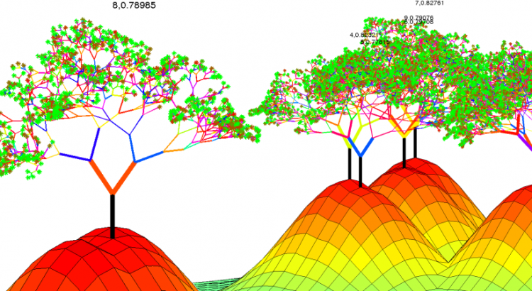
Random Forest

Slide 21
Machine Learning: Random Forest
Decision Tree
Root Node
Internal Node
Internal Node
Leaf Node
Leaf Node
Leaf Node
Leaf Node

Slide 22
Machine Learning: Random Forest
Decision Tree
Question 1
Yes
No
Question 2
Leaf Node
Yes
No
Leaf Node
Leaf Node

Slide 23
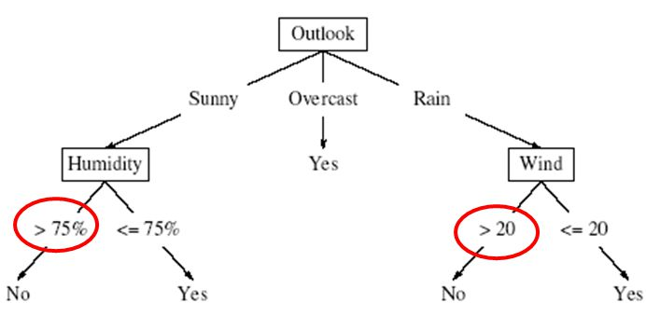
Machine Learning: Random Forest
Decision Tree – continuous data

Slide 24


Random Forest
Uses a random subset of the original data to create many decision trees.
Samples with replacement from original
Data

Slide 25
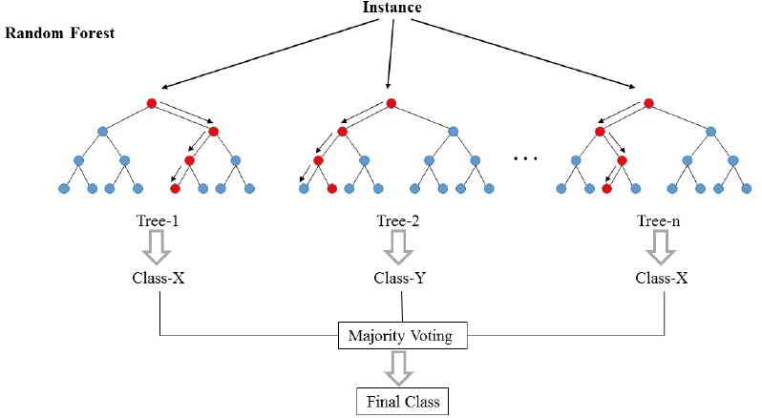
Random Forest
Then takes those data to construct independent decisions trees
Each tree ends at leaf node and makes prediction
Those independent predictions are then used to make a statement of the original data

Slide 26
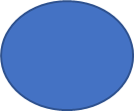
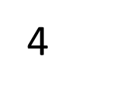
Random Forest
Predicts 3 twice
Predicts 1 once
Go with 3
1
2
3
1
2
3
1
2
3

Slide 27
Random Forest Weak Learner
a weak learner is a prediction function that has low bias.
Generally, low bias comes at the cost of high variance, so weak learners are usually not accurate predictors.
Averaging weak learners, over many training sets, gives estimates with low bias and low variance.
Each decision tree within the random forest is a weak learner

Slide 28
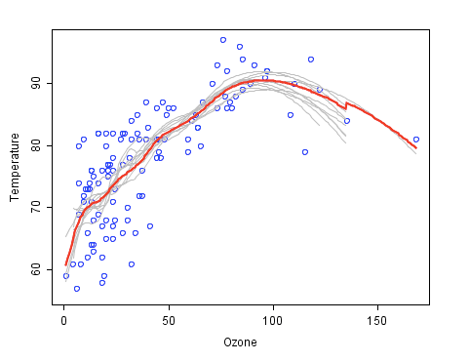
Random Forest Weak Learner
Each gray line is an individual decision tree
Or Weak Learner
The Red curve is an ensemble of the weak learners and better approximates the underlaying data

Slide 29
Random Forest Out-of-Bag
We can choose what percentage of the data to use for bootstrapping
The data not used in the bootstrapping is the Out-of-Bag data
We can measure how accurate the random forest is by the proportion of Out-of-Bag samples that were correctly classified

Slide 30
Random Forest Parameters
We can tell the model how many trees to construct
We can decide how much of the data to use for bootstrapping
We can choose how many variable to consider at each node
Rule of thumb is number of variables squared

Slide 31
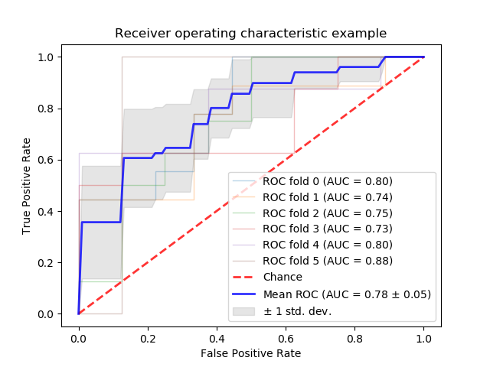
Random Forest Evaluation

Slide 32
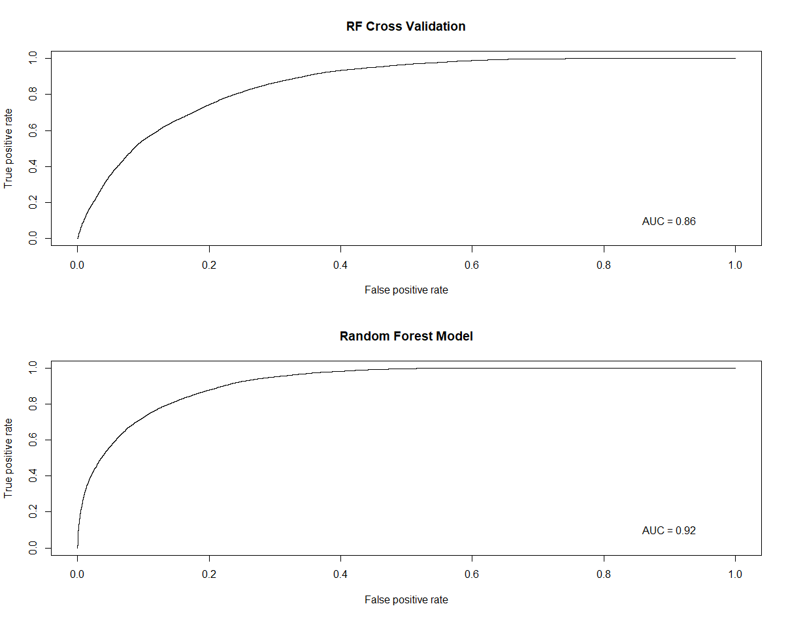
Random Forest Evaluation

